Slide 1
Establishment of Parentage
Maryland Joint Child Support Conference
October 2019

Slide 2
Methods of Establishing Parentage
Establishment of parentage is a process of obtaining a legal finding of parentage of a child born out of wedlock. Parentage may be established in various ways. Parentage is considered fully established when:
Unmarried parents completed an Affidavit of Parentage after July 1, 1997:
The court has issued an order for parentage;
The child was born or conceived during a marriage and is presumed to be the legitimate child of both spouses;
The biological parents of a child born out of wedlock, of whom parentage has not been fully established, subsequently marry;
A child is adopted; or
Parentage was established in another state in accordance with the laws of that state.

Slide 3
Capturing Establishment of Parentage on CSES
Federal mandates require States to maintain records necessary for proper, efficient operation including those records regarding actions taken to establish parentage.
Parentage data is stored in CSES on the Child Data Screen. The following codes are to be used, as deemed appropriate by their explanation, on the “Paternity Established?” field on the Child Data Screen:

Slide 4
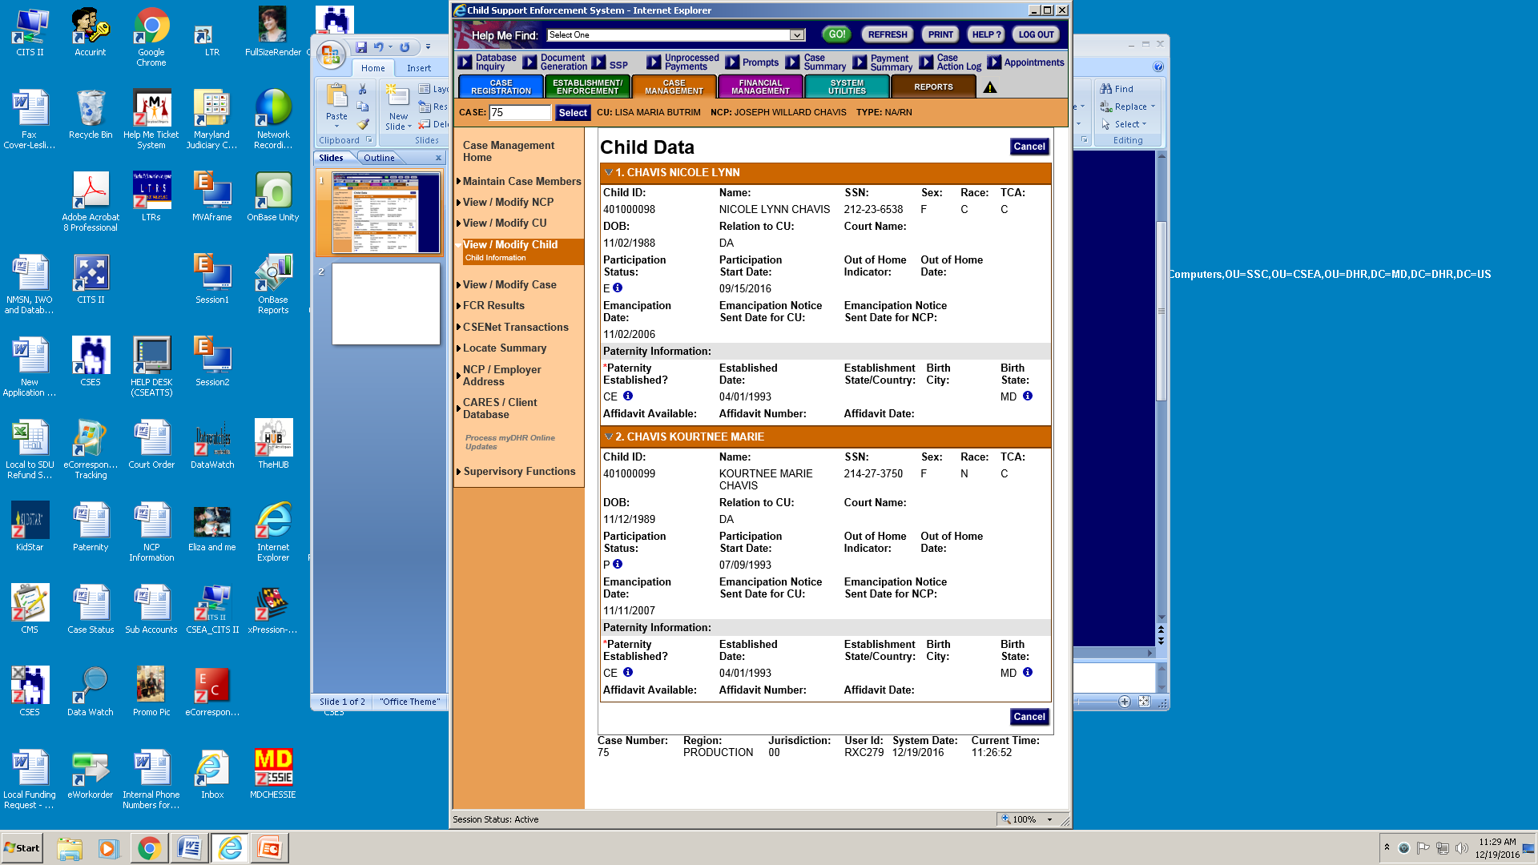

Slide 5
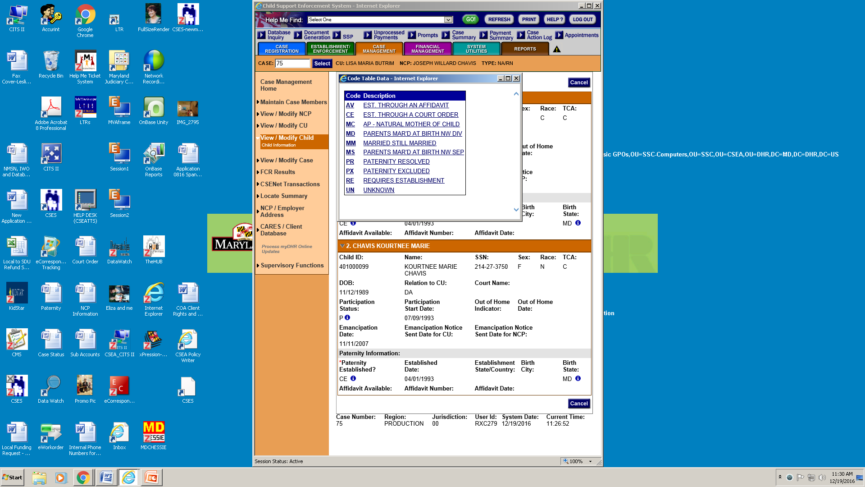

Slide 6
“AV” (Est. through an Affidavit)
“AV” (Est. through an Affidavit) – to be used when the parentage of the child was established through an Affidavit of Parentage.
The field may be populated through the automated Department of Vital Records (DVR) interface (Maryland affidavits only) or input by the local office worker.

Slide 7
“CE” (Est. through a Court Order)
“CE” (Est. through a Court Order) – to be used when the parentage of the child has been determined through a court order (consent or genetic testing) and no Affidavit of Parentage pre-dating the court order is on file with DVR.
Under Maryland law, when a court issues an order requiring a parent to pay child support, the parent has been judicially determined to be a parent. There is no need to obtain copies of underlying documents.
If the order is from another state, and does not contain paternity establishment language, contact that state to obtain acceptable documentation of paternity establishment.
Acceptable documentation would include a copy of the underlying complaint or petition, copy of the other state’s law that deems an order for support automatically established parentage, or that genetic test results legally establish parentage without further action required.

Slide 8
“MC” (AP-Natural Mother of Child)
“MC” (AP-Natural Mother of Child) –The CSE worker should refrain from using MC because it does not establish paternity; it merely defines the NCP–child relationship.
The CSE worker should select the appropriate code that describes the parentage establishment status of the child’s non-biological parent.
The "MC" code should be used if all other means of recording paternity data have been exhausted and the NCP is the natural mother of the child.

Slide 9
“MD” (Parents Mar’d at Birth Nw Div)
“MD” (Parents Mar’d at Birth Nw Div) – to be used when the child was conceived or born of the marriage and the parents are now divorced.
The requester of service is not required to provide a marriage certificate or divorce decree.

Slide 10
“MM” (Parents Mar’d/Still Mar’d)
“MM” (Parents Mar’d/Still Mar’d) – to be used when the child was conceived or born of the marriage, the parents are still married and living together, but the child is not in the home.
This is particularly applicable for DJJ, Foster Care, and Voluntary Placement cases.

Slide 11
“MS” (Parents Mar’d at Birth Nw Sep)
“MS” (Parents Mar’d at Birth Nw Sep) – to be used when the child was conceived or born of the marriage, but the parents are now separated.
The customer requesting service is not required to provide a marriage certificate.

Slide 12
“PR” (Paternity Resolved)
“PR” (Parentage Resolved) – to be used when parentage has been resolved.
The code applies to cases in which the child was:
  (1) adopted;
  or (2) under limited circumstance where the child was legitimized by marriage under MD law.
  Specifically, the code may be used when the child was born out-of-wedlock, the parents subsequently marry, separate, and subsequently a court order was established for support with no language addressing non-biological parentage either in the order or in the complaint for support.

Slide 13
“PX” (Paternity Excluded)
“PX” (Paternity Excluded) – to be used when genetic testing has determined the putative father is not the biological father. The subject child should be made non-participating and, if there are no other participating children on the case for whom paternity can be or has been established, the case should be closed.
Note: In cases with an executed Affidavit of Parentage which is over 60 days old, but as a result of court-ordered genetic testing the putative father is found not to be the biological father, the existing “AV” code should be removed and replaced by the "PX" code.
The Clerk of Court is required to notify the Division of Vital Records (DVR) of each paternity disestablished (or established) by the Court.

Slide 14
“RE” (Requires Establishment)
“RE” (Requires Establishment) – to be used when the child was born out of wedlock and parentage has not been established.
There is no Affidavit of Parentage (AOP) on file with DVR or the Affidavit of Parentage was rescinded

Slide 15
“UN” (Unknown)
“UN” (Unknown) – to be used when the parentage status of the child is unknown or cannot be verified.

Slide 16
“Locked Down” Parentage Codes
The following Parentage Establishment Codes on CSES are “locked down”: AV, CE, MC, MD, MM, MS, PR & PX.
Once committed to CSES, only a supervisor with Role 12 will be able to modify the parentage code and date.
A CSES monthly report, “Paternity Override Code”, identifies cases in which a supervisor modified a parentage code and date.
This report is stored in RMDS and Datawatch.

Slide 18
Capturing the Parentage Establishment Date
Once parentage has been established, the CSE worker shall enter the date parentage was established in the "Established Date" field on the Child Data screen. Following is a list of codes, the scenarios associated with the codes, and the corresponding establishment dates:
AV – Parentage established by Affidavit of Parentage (Affidavit) – Enter the date the Affidavit was executed. See Section D 402.2 Date of Execution. This should be the same date that appears in the Affidavit Date field on the Child Data screen.
CE – Parentage established by court order. Enter the date of the order, i.e. the date the Judge signed the order.
PR – Parentage was resolved. This is used when:
  The child was adopted – enter the date the adoption was final; or
  Under limited circumstances, the child was legitimized by marriage ,enter the date of the order, i.e. the date the judge signed the order for support.
  a court order was established for support for a child with no language addressing non-biological parentage either in the order or in the complaint for support.
MD, MM, MS – The child was born of the marriage; use the child’s date of birth.
PX, RE, UN, MC – The date should be blank.

Slide 20
Capturing the Parentage Establishment State/Country
Once parentage has been established, the CSE worker shall enter the state or country where parentage was established in the "Establishment State/Country" field on the Child Data screen.

Slide 22
Capturing the Birth City
The CSE worker shall enter the city where the child was born in the “Birth City" field on the Child Data screen.

Slide 24
Capturing the Birth State
The CSE worker shall enter the state where the child was born in the “Birth State" field on the Child Data screen.

Slide 25
The Affidavit of Parentage (Affidavit)
The in-hospital paternity acknowledgement program gives unmarried parents an opportunity to voluntarily acknowledge parentage at or around the time of the child’s birth. Appropriate hospital staff must offer unmarried parents an opportunity to sign the voluntary acknowledgement, entitled the Affidavit of Parentage (Affidavit), at the hospital. The parents may sign at the hospital or take the Affidavit home and sign later.
The hospital forwards the Affidavits signed at the hospital to the state agency designated to receive them. In Maryland the agency designated to receive and store the Affidavits is the Department of Health and Mental Hygiene, Division of Vital Records (DVR). If the unmarried parents sign the Affidavit after the mother’s release from the hospital, it is their responsibility to send it to DVR at the address supplied on the back of the Affidavit.
By state law DVR shall make the Affidavit available to the child’s parents or guardian, or a CSA agency upon request.
Affidavits are also available to CSA workers through the University of MD, SSW

Slide 26
Changes to the Program
Effective June 1, 2019, Maryland Family Law § 5-1028 was amended to provide that the Affidavit can also be used to establish parentage when an unmarried mother gives birth to a child conceived through assisted reproduction, so long as both parents agreed to conceive the child through assisted reproduction and to both be the child’s parents.

Slide 27
Changes to the Program
The legislation also made the Affidavit gender-neutral, so instead of using the terms “mother” and “father,” it now refers to the parent who gave birth to the child and the parent who did not give birth to the child.
Once the Affidavit is signed, the child is considered the legal child of both the parent who gave birth to the child and the parent who did not give birth to the child.
The term “paternity” has been replaced with the term “parentage”.

Slide 28
Affidavit Rescission
Any person who signs the Affidavit has the right to rescind it within 60 days.
After the expiration of that 60 day period, the Affidavit can only be set aside by a court.
If a father who signed an Affidavit of Parentage on the basis that he is the child’s father wants a genetic test, the father must first obtain a court order for testing.

Slide 29
Affidavit Rescission
Under Faison v. MCOCSE ex rel. Murray, 235 Md. App. 76 (2017), the father is legally entitled to a test if he believed he was the biological father when he signed the Affidavit.
Only the court can make this decision; it should not be determined by the caseworker.
The father may ask the court to order testing during a child support proceeding, but CSA should not file a case on behalf of a father seeking to obtain testing to disestablish paternity.
The father is not entitled to a test if he signed the Affidavit knowing he was not the biological father.

Slide 30
Affidavit Rescission
Even if the test results show that the individual who signed the affidavit as the father is not the biological father, that individual still has the burden to prove to the court that there was fraud, duress, or a material mistake of fact in order to disestablish paternity. FL § 5-1028(d)(2).
The mother of a child who signs an Affidavit identifying an individual as the only possible father cannot later disestablish the father’s parentage. Boone v. Youngbar, 234 Md. App. 288 (2017).

Slide 31
Capturing the Affidavit Available Information
The CSE worker may enter a “Y” or “N” to indicate if there is an affidavit available in the “Affidavit Available" field on the Child Data screen.

Slide 32
Capturing the Affidavit Number
The CSE worker may enter the Affidavit Number in the “Affidavit Number" field on the Child Data screen.

Slide 33
Capturing the Affidavit Date
The CSE worker may enter the date the Affidavit was finalized in the “Affidavit Date" field on the Child Data screen.

Slide 34
Understanding Paternity Performance
The Statewide Paternity Establishment Performance (PEP) is measured each Federal Fiscal Year (FFY).
Each state must maintain 80% in PEP to receive full Federal Financial Participation (FFP) for its child support program, and maintain 90% in PEP in order to receive full funding for its annual TANF (Temporary Assistance for Needy Families) block grant.
The State of Maryland uses the statewide PEP, which is calculated by dividing The Numerator (the number of paternities established statewide in a given FFY) by The Denominator (the number of children born out of wedlock statewide in the preceding FFY).
Under the statewide PEP, CSEA has no control over the denominator.

Slide 35
Understanding Paternity Performance
The numerator includes all IV-D paternities and non-IV-D paternities in a FFY.
CSEA has limited control over the numerator through management of its IV-D cases.
The data for both types of paternities is captured by the Department of Health and Mental Hygiene (DHMH) Division of Vital Records (DVR).
Each establishment of parentage in a given FFY increases the numerator by one for that FFY and helps to achieve the statewide PEP standard.

Slide 36
Improving Paternity Performance
Performance is improved by establishing parentage one child at a time.
In order to increase the numerator by one, the CSE worker must
  1) capture parentage for a child that:
    a) was born out of wedlock, and
    b) does not already have paternity established on another child support case, as well as

Slide 37
Improving Paternity Performance
      2) have selected one of the three paternity establishment codes that increase the numerator (AV, CE, or PR).
      3) update the paternity establishment state/country to Maryland.
        Use of the following codes do not increase the numerator but they should be used as appropriate (MC, MD, MM, MS, PX, RE, and UN).

Slide 38
Important Parentage Note
If parentage was established by more than one method, the CSE worker shall select the method that first established parentage.

Slide 39
FFY2019 Paternity Performance
1

Slide 40
Paternity Clean Up Report
1

